Slide 1
Behind the Scenes
Art Class
Santiago Ortiz Velasco

Slide 2
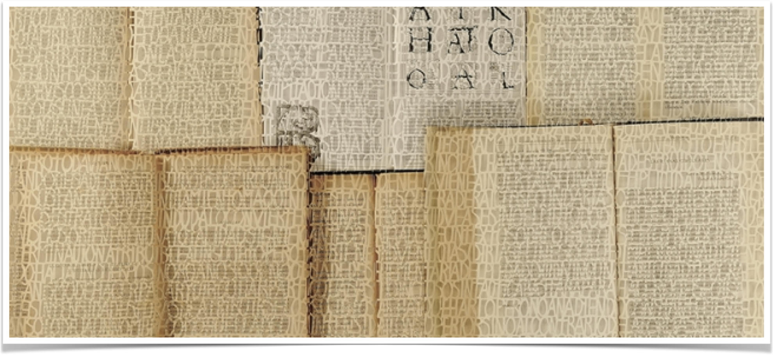
Pablo Lehmann
Referential Analysis
He is an Argentinian artist from the National School of Arts with a bachelor degree. He has made different installations using different techniques such ass the textile Sculpture and Blackout Poetry.

Slide 3
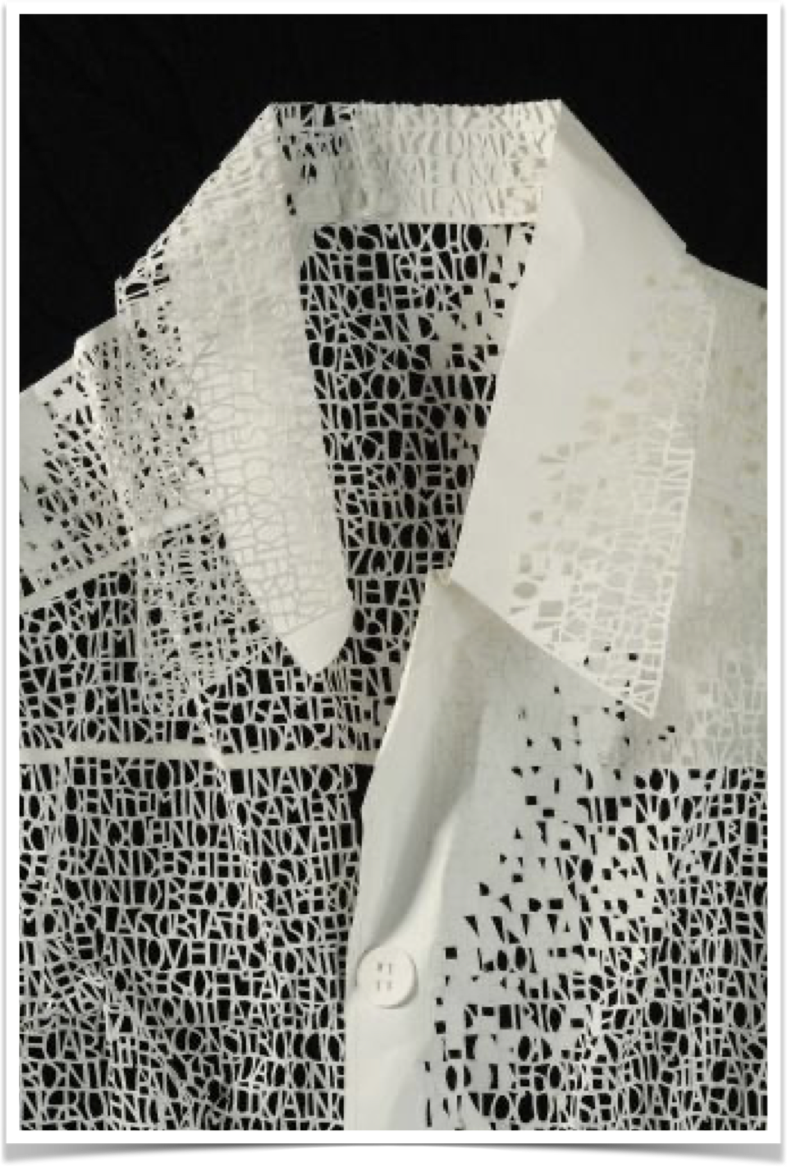
Visual Poetry: Conceptual Reference
Pablo Lehmann
In this art piece Pablo Lehmann through the cut words changes the meaning of the object (shirt) and transform it into poem inscribed in the shirt. He tries to communicate with the audience in a different way.
Art Form: Textile Sculpture
Materials: Textile (shirt)
Format: 60 cm x 90 cm

Slide 4
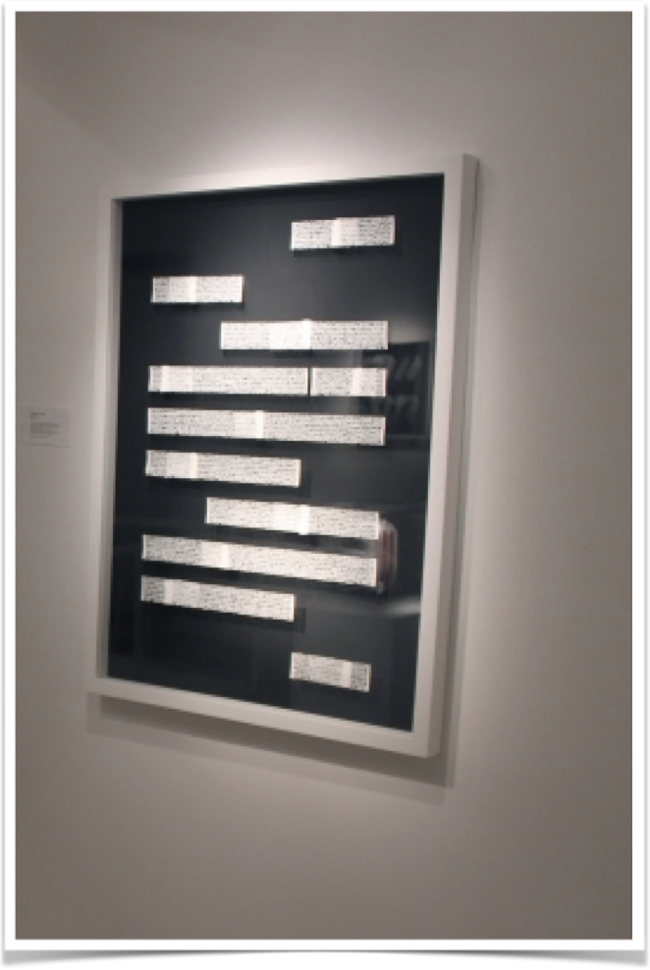
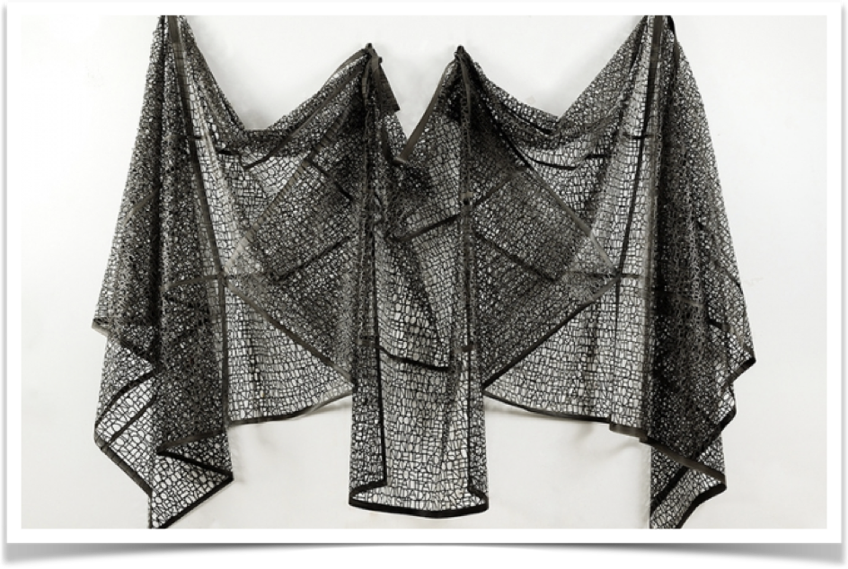
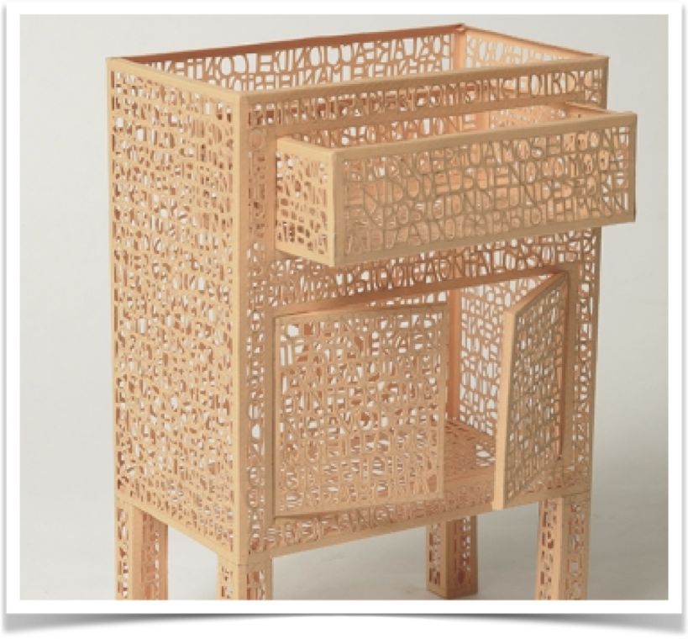

Slide 5
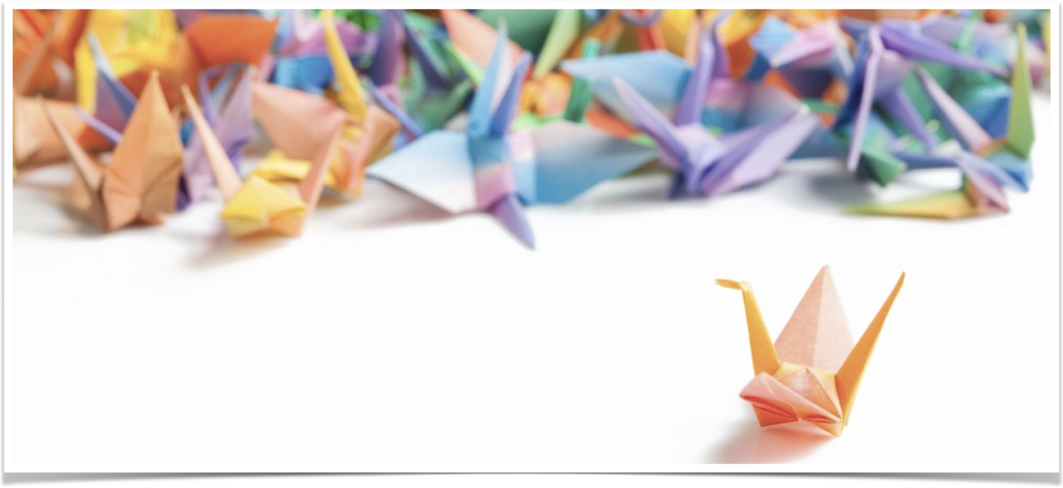
Origami
Aesthetic Reference
The origami is a form of art that takes back to the I and II century in China that is used to create paper sculptures using different folding techniques that do not require any type of glue or cutting work in the process.

Slide 6
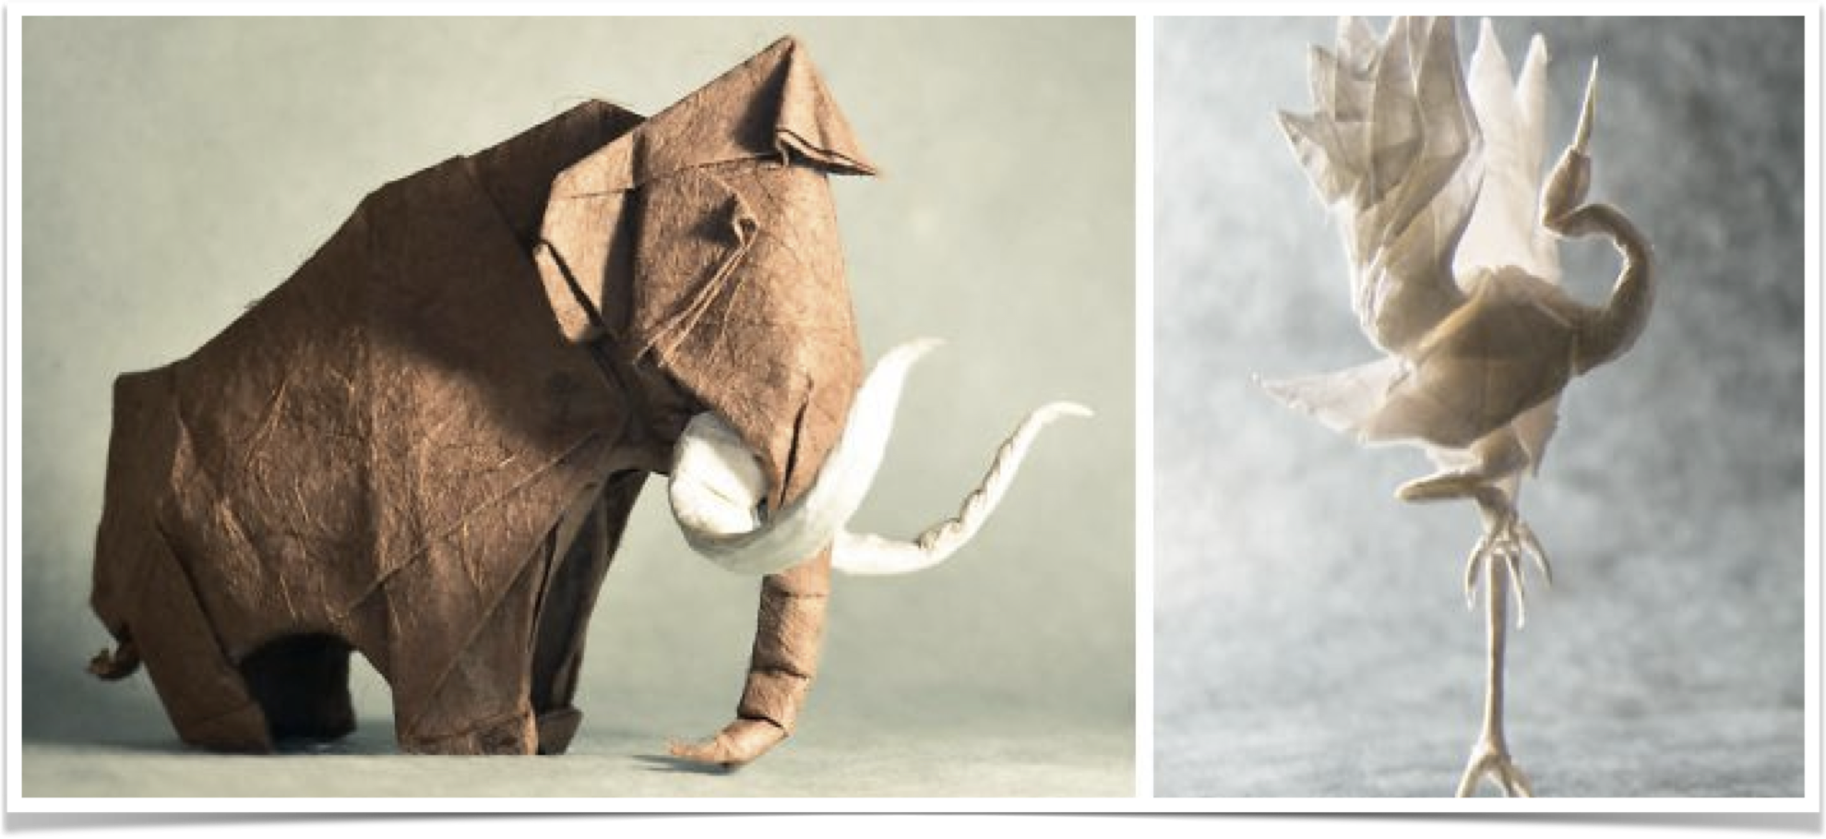
Origami
Aesthetic Reference
Art Form: Sculpture
Materials: Paper
Format: Small Size Sculptures

Slide 7

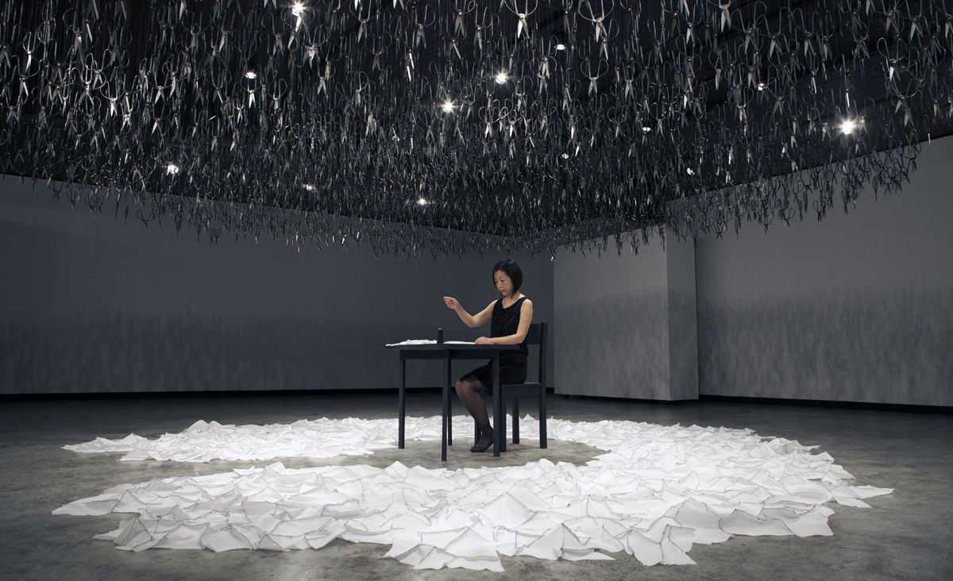
beili liu
1200 × 732
1200 × 732
Conceptual/ Aesthetic Reference
Beili Liu is a visual artist that works with installations using commonplace materials and elements that can be threatening like scissors, fire, paper, stone and much more.

Slide 8
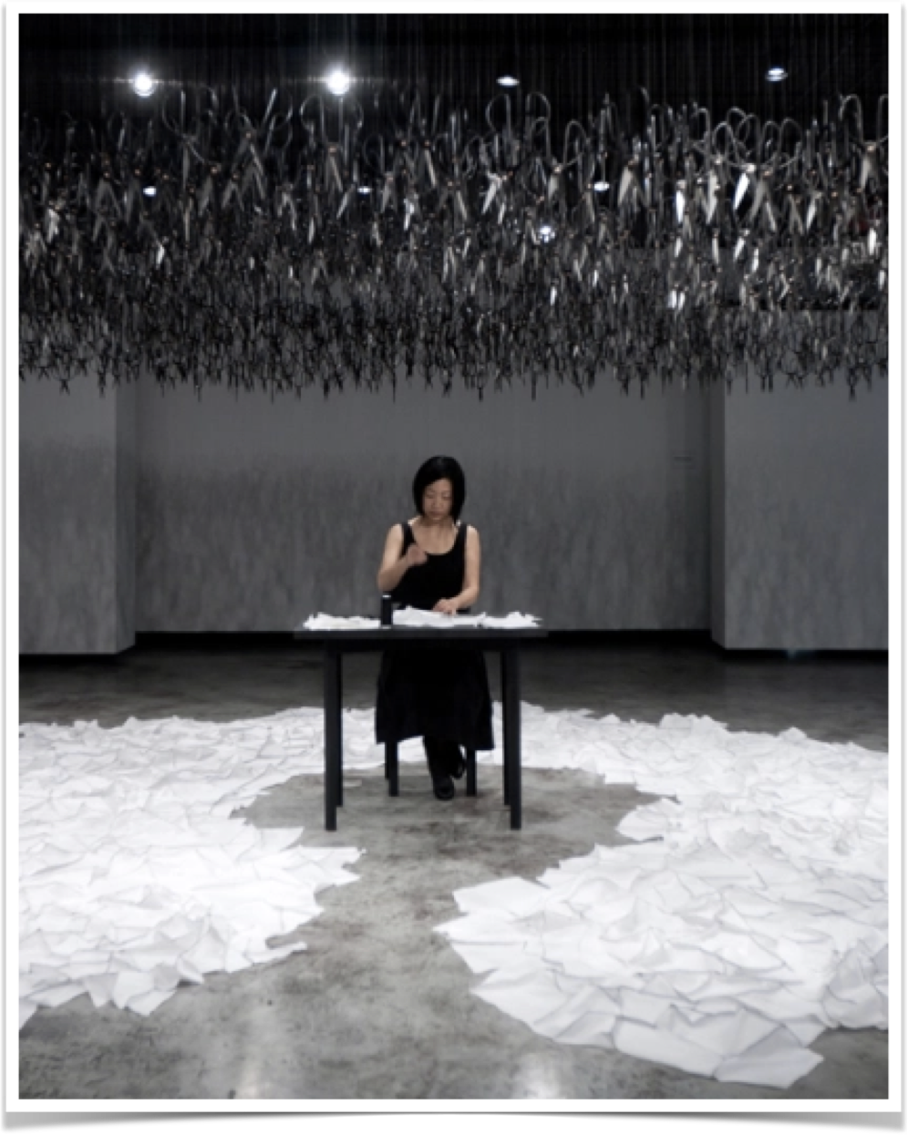
Beili Liu
Aesthetic Reference
Her works are performances that are ordinary acts that repeat and the space changes through Time. In this performance she is sewing and the space changes through time while the piece she is sewing gets bigger and bigger. The scissors in the ceiling are a symbol that represent the opposite of what she is doing.( Cut - Sew).
Aesthetics:
Art Form: Performance art/Installation
Materials: scissors, textile, threat and a needle, desk.
Format: Exposition Room

Slide 9
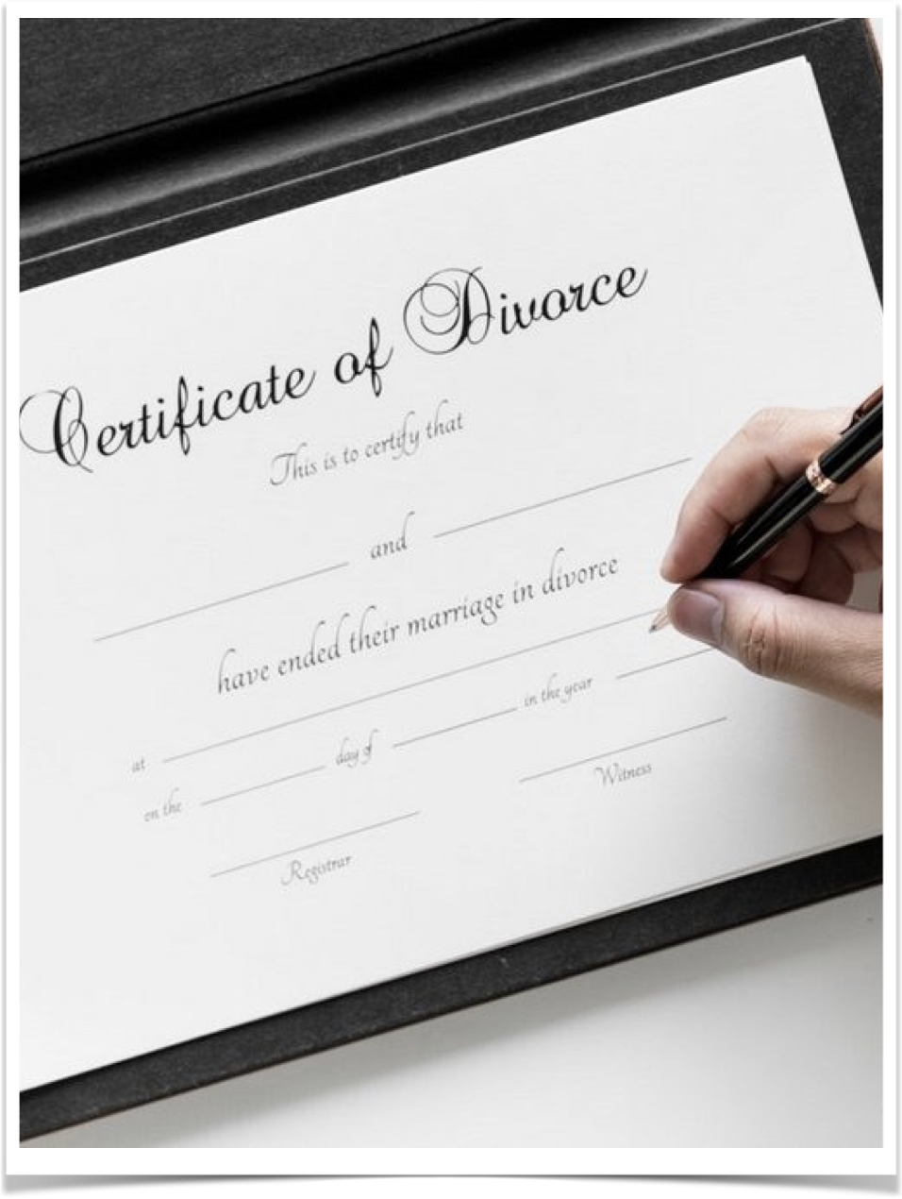
Sketch
My work will be a performance act based on the divorce of my parents and how this impacted my life. In this performance will be included the origami folding techniques, the transformation of meaning of the object used by Pablo Lehmann and the visual poetry in the divorce papers , and the type of performance of changing the space used by beili liu.
Aesthetics: Art Form: Performance Art
Materials: Divorce Papers, Pen, Origami Book.
Format: Video

Slide 10
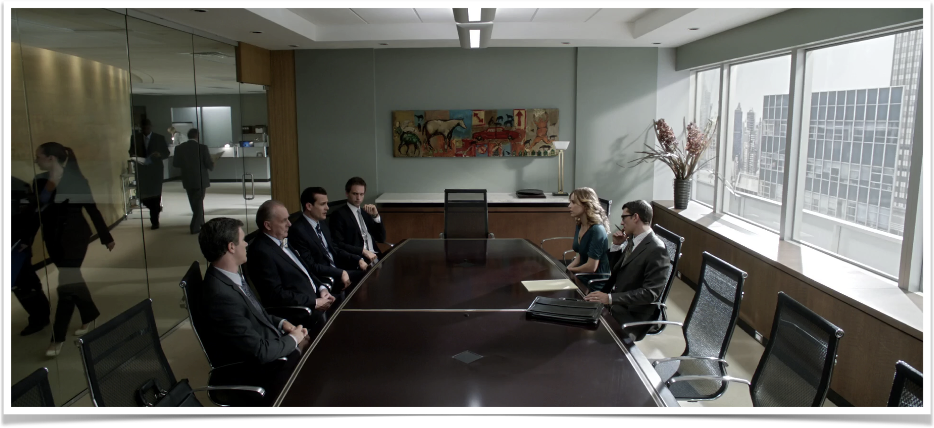
Curatorial Sketch
I will use this space due to the fact that a conference room such as this one is where the legal actions over a divorce are taken place and it adapts to my idea of the performance very well. The body in this space is seen in the main performer that does the actions with the divorce papers.

Slide 14
Reference Card
Name: Santiago Ortiz Velasco
Title: Behind the Scenes

